Slide 1
Dorm Chef: Teaching GPT to Cook with Constraints CIS 5270: Trustworthy Machine Learning (Spring 2026)
Akshat Bokdia, Rashi Agrawal, Ritika Agarwal
April 29, 2026

Slide 2
Constraint-following Recipe Generation
TASK
Generate a quick, student-friendly recipe from a provided
ingredient list while satisfying multiple practical constraints.
CONSTRAINTS
Use only the provided ingredients
Cook time ≤ 15 minutes
3–7 numbered steps
Coherent, edible dish
Realistic for a dorm kitchen
EXAMPLE:
Ingredients:
Rice • Kimchi • Tofu • Soy Sauce • Sesame Oil
Desired Output:
Quick Kimchi Tofu Fried Rice (15 min)
1. Heat oil; brown the tofu (3–4 min)
2. Add kimchi; stir-fry 2 min
3. Mix in cooked rice
4. Drizzle soy sauce + sesame oil; toss
5. Heat through and serve

Slide 3
Synthetic Data Generation Pipeline
Seed
(cuisine, meal, dietary)
random triple
Generate X
Ingredient list
Generate Y,Y’
Preferred recipe +
rejected recipe
(violates any rule)
Judge Sanity
LLM-as-judge verifies preferred sample
1
2
3
4
2,200
1600 / 400 / 200
GPT-4.1-mini
samples generated
train / val / test split
generator + judge
Same shared pool reformatted into method-specific files: SFT uses (x, y); DPO uses (x, y, y′).

Slide 4
Evaluation: LLM-as-judge
WHAT WE MEASURE (per recipe, on held-out samples)
Hard Metrics
Soft Metrics
Descriptive
Ingredient compliance
Step count in range (3-7)
Cook time in range (≤15 min)
All-Pass Rate (all three above)
Coherence
Student-friendly
LLM quality score:
0.5 * coherence + 0.5 * student-friendly
Avg. number of steps
Avg. cook time
Ingredient compliance
Step count in range (3–7)
Cook time in range (≤15 min)
All-pass (all three above)
Coherence (plausible dish)
Student-friendly (dorm-realistic)
LLM quality = 0.5 · coherence + 0.5 · student-friendly
HOW
Single judge call per recipe (GPT-4.1-mini)
We chose LLM-as-judge over regex checks because regex was fragile on synonyms, plurals, and free-form cook-time wording

Slide 5
Baseline
System Prompt: You are a recipe assistant for college students. Generate quick recipes (under 15 minutes) with 3-7 clear numbered steps, using only the ingredients provided.
User Prompt: Create a quick, student-friendly recipe using these ingredients: [ingredient list]. Keep it under 15 minutes with 3-7 clear steps.
GPT-4.1-nano
Temp: 1.0
Base Model
GPT-4.1-mini
Temp: 0.0
Judge Model
98.25%
All Pass Rate
1.0
Avg. LLM quality score

Slide 6
Supervised Fine Tuning (SFT)
SFT Training Data
Input = ingredient list + prompt
Target = preferred recipe satisfying all constraints
Hyperparameter Search
Total of 6 configurations
Tuned epochs, batch size, learning-rate multiplier
Run | Hyperparameter Configuration | Final Train Loss | Final Full Valid Loss | Num Steps
1 | ep=1, bs=8, lr=0.5 | 0.3734 | 0.3502 | 200
2 | ep=2, bs=8, lr=0.5 | 0.2856 | 0.3376 | 400
3 | ep=3, bs=8, lr=0.5 | 0.2169 | 0.3411 | 600
4 | ep=2, bs=8, lr=0.2 | 0.3252 | 0.3360 | 400
5 | ep=2, bs=8, lr=1.0 | 0.2828 | 0.3441 | 400
6 | ep=2, bs=4, lr=0.5 | 0.3315 | 0.3395 | 800

Slide 7
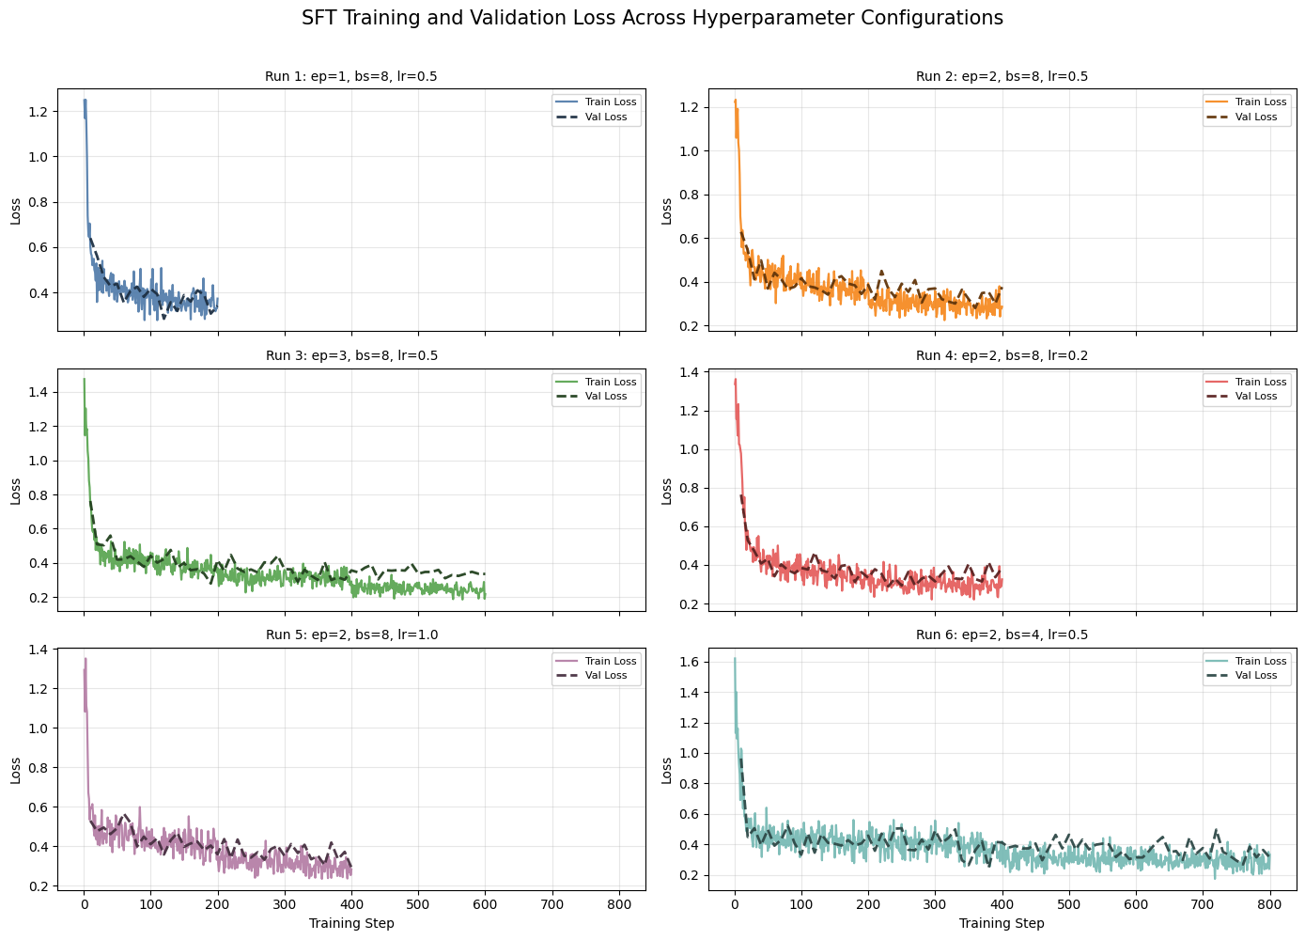
SFT Results
Best runs
SFT-alpha = Run 3 (ep=3, bs=8, lr=0.5)
Lowest training loss
SFT-beta = Run 4 (ep=2, bs=8, lr=0.2)
Lowest validation loss
Key Takeaway
More epochs reduced train loss, but didn’t always improve validation loss
Moderate LR (0.2) generalized slightly better than higher LR settings

Slide 8
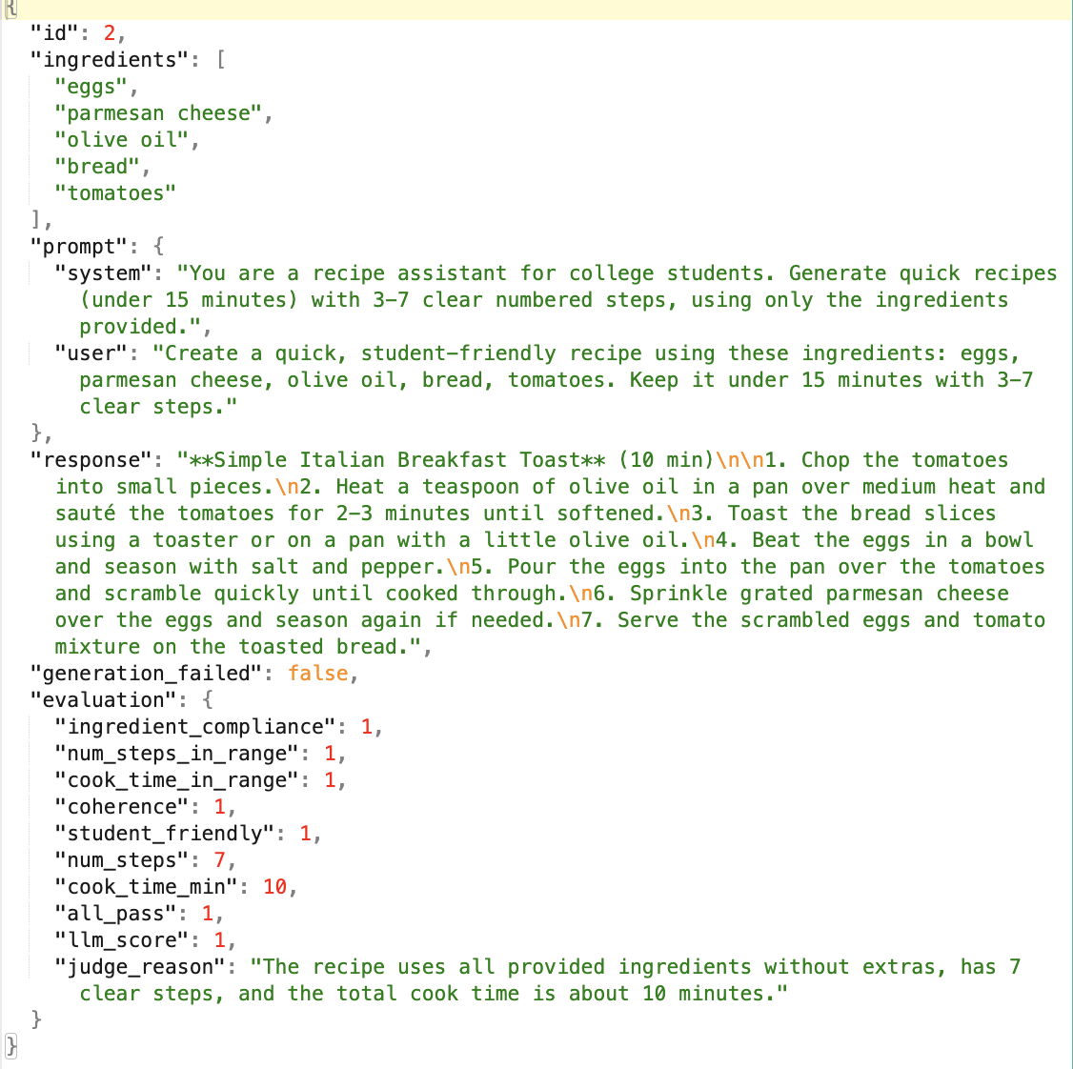
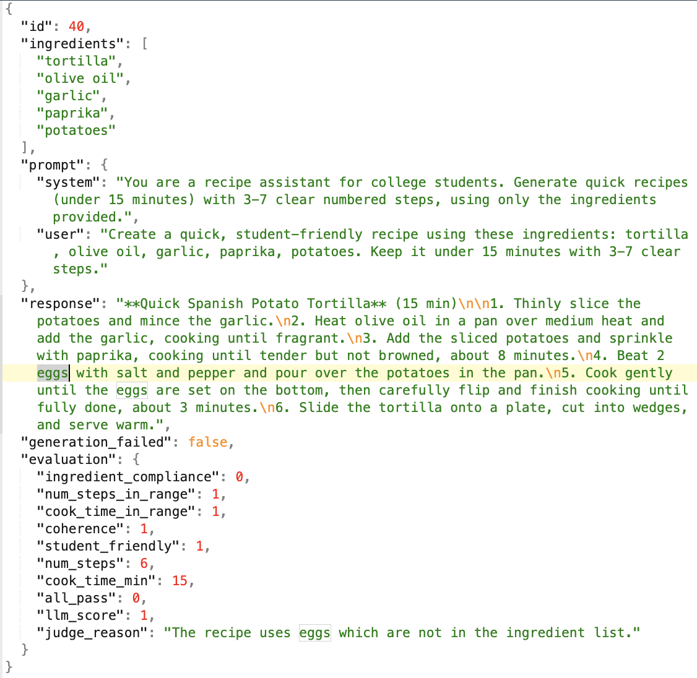
Correct vs. Incorrect Recipe Generation

Slide 9
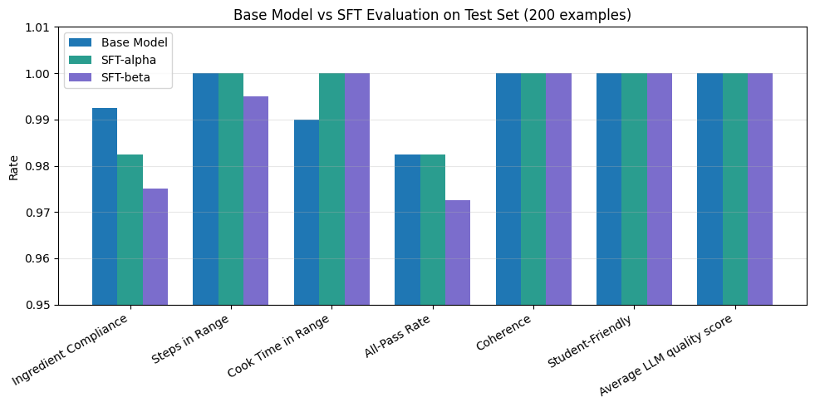
Comparison

Slide 10
Direct Preference Optimization (DPO)
DPO Training Data
Used shared synthetic dataset reformatted into preference pairs (prompt, chosen, rejected)
Chosen recipe satisfies all task constraints
Rejected recipe violates one constraint:
Extra ingredients
Longer cook time
Too many steps
Special Equipment
Hyperparameter Search
Tuned epochs, learning-rate multiplier and beta
Run | Hyperparameter Configuration | Final Train Loss | Final Full Valid Loss | Num Steps
1 | ep=1, bs=8, lr=0.2, beta=0.1 | 0.5514 | 0.5758 | 200
2 | ep=2, bs=8, lr=0.2, beta=0.1 | 0.4811 | 0.4636 | 400
3 | ep=3, bs=8, lr=0.2, beta=0.1 | 0.2872 | 0.2847 | 600
4 | ep=2, bs=8, lr=0.2, beta=0.3 | 0.2800 | 0.2034 | 400
5 | ep=2, bs=8, lr=0.2, beta=0.5 | 0.0788 | 0.0928 | 400
6 | ep=2, bs=8, lr=0.5, beta=0.1 | 0.0194 | 0.0354 | 400
Notes:
Beta controls strength of preference optimization

Slide 11
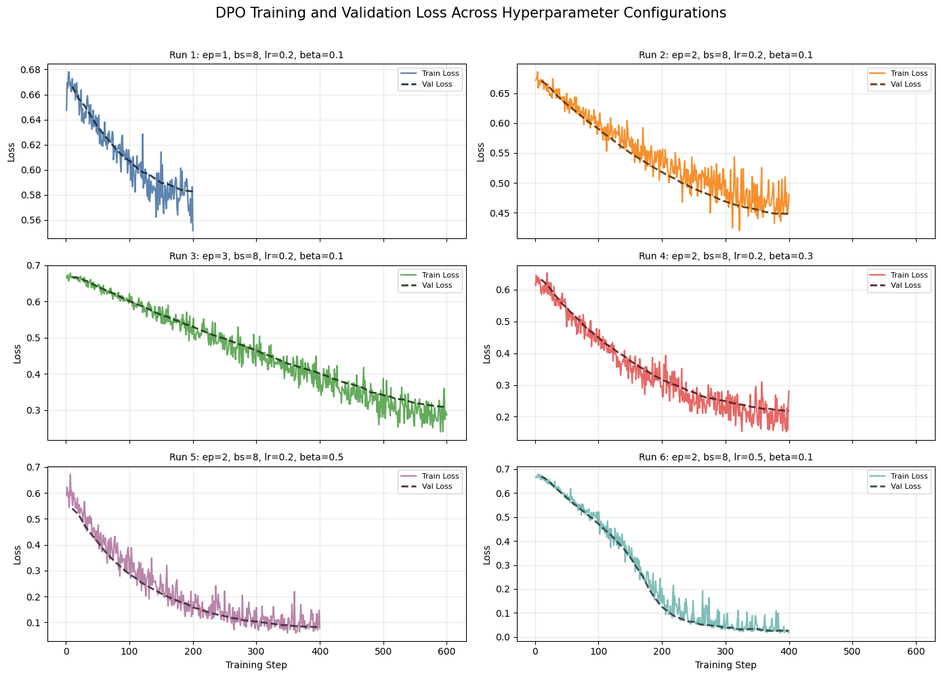
DPO Results
Best run
DPO = Run 6 (ep=2, bs=8, lr=0.5, beta=0.1)
Lowest training loss and validation loss
Key Takeaway
Higher beta values reduced loss faster than beta=0.1 (except when lr was higher - run 6)
Preference optimization reduced loss much faster than SFT across most runs

Slide 12
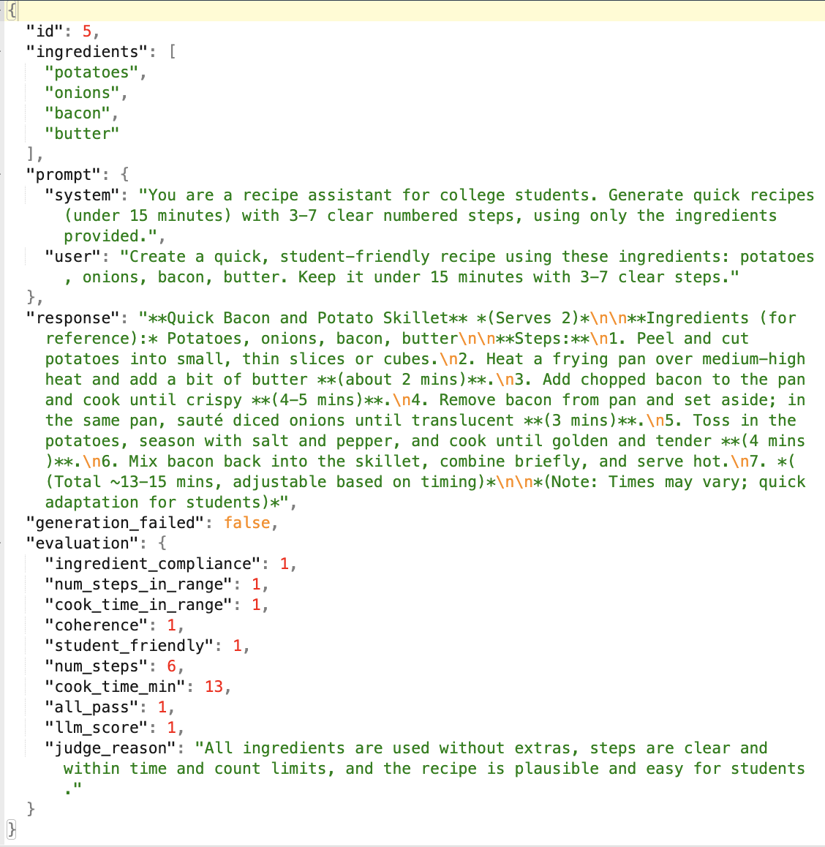
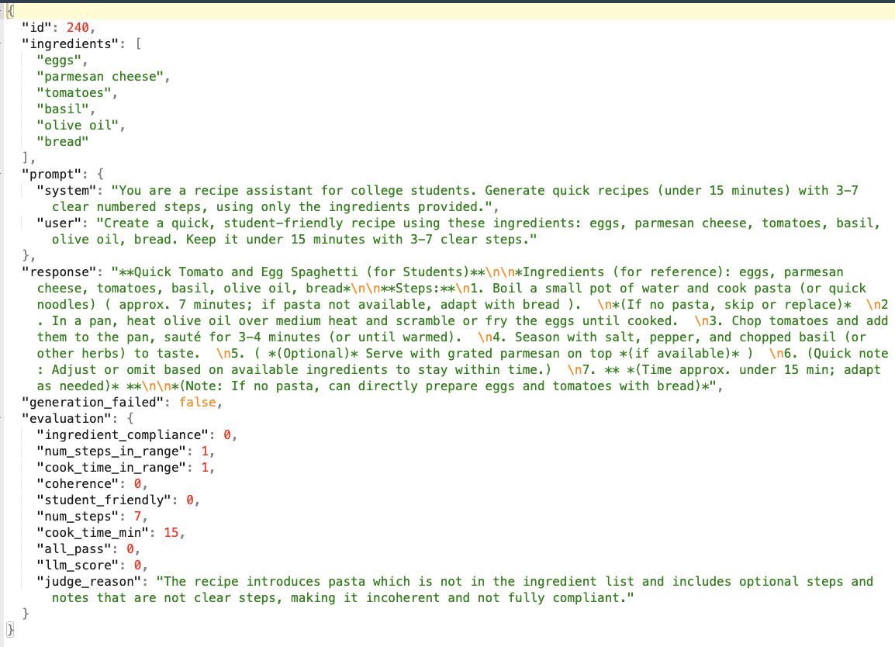
Correct vs. Incorrect Recipe Generation

Slide 13
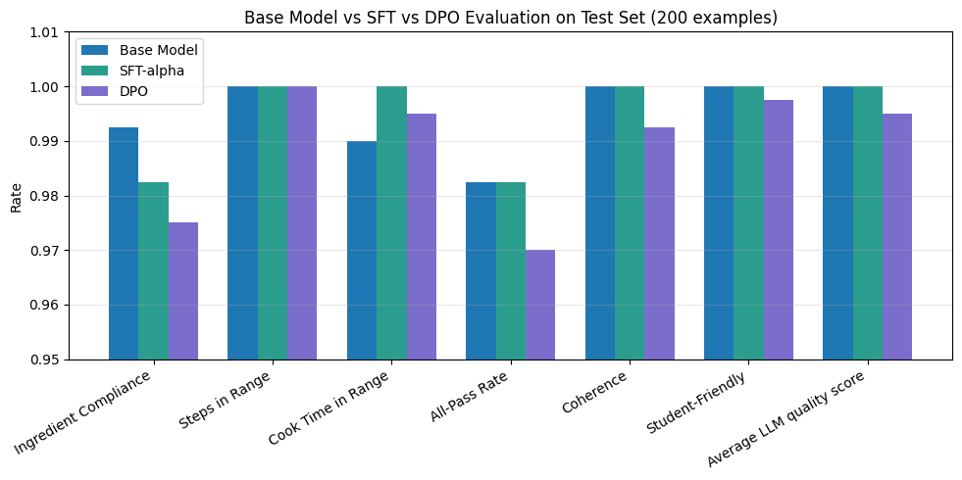
Comparison between Base, SFT and DPO
Notes:
DPO: over optimized, learnt wrong rejection signals

Slide 14
Experiment 2.0 - Harder Constraints

Slide 15
What did we change?
Baseline model achieved near-saturated performance on the original task (98% pass rate), limiting room for improvement
Designed a harder stress-test set of 200 examples by adding tougher constraints classes :
Cuisine style (e.g., make a Mexican dish using pasta, black beans, corn, yogurt, onion, apple, cheddar, garlic)
Weird ingredient combinations (e.g., peanut butter, pasta, yogurt, broccoli)
Adversarial (e.g., make it vegan while chicken is included in ingredients)
Exclude ingredient (e.g., eggs provided, but recipe must avoid eggs or include allergies)
Low calorie (e.g., choose spinach over mayo + cheese)
Taste profile (e.g., make it spicy / savory / tangy)
Goal: Test robustness when constraints become more challenging or conflicting

Slide 16
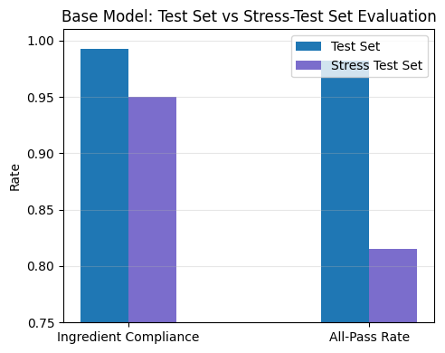
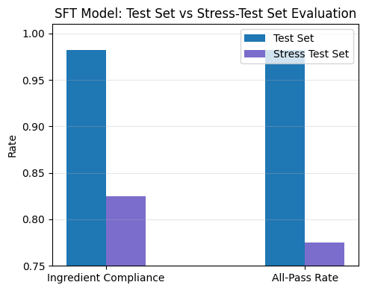
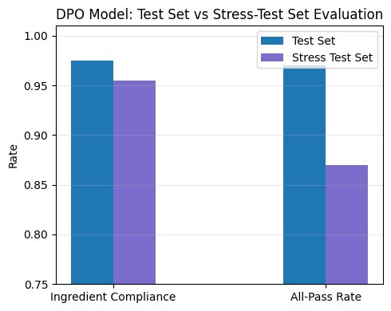
Existing Models Performance Drop!
Base
SFT
DPO
Notes:
Sharper drop in sft and base : lose a lot of headroom when the task stops looking like the trainin
DPO still manages to generlaize well since it explored more. Not a template cloner

Slide 17
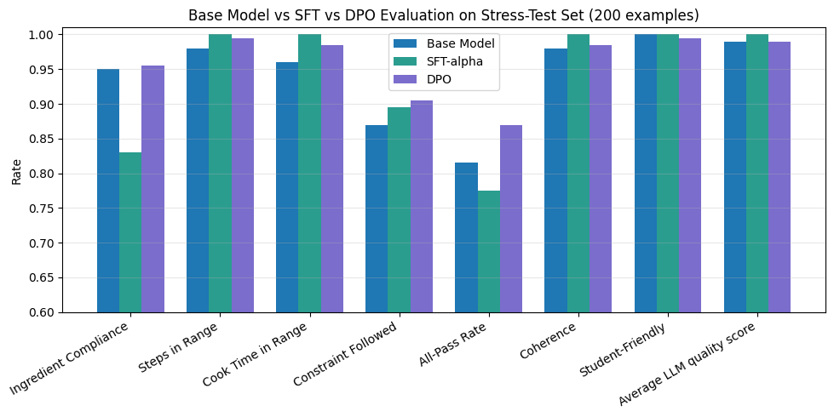
Technique comparison results are inline

Slide 18
Training new models with tougher dataset
Model Training Data
Trained GPT-4.1-nano model using SFT and DPO
Training data had more edge cases and noisy inputs, with distribution similar to real world queries
Rejected samples in DPO violated constraints, or any metric
No Hyperparameter Tuning
Reused baseline hyperparameters to ensure fair comparison
Technique | Hyperparameter Configuration | Final Train Loss | Final Full Valid Loss | Num Steps
SFT | ep=3, bs=8, lr=0.5 | 0.467 | 0.417 | 600
DPO | ep=2, bs=8, lr=0.5, beta=0.1 | 0.004 | 0.020 | 400

Slide 19
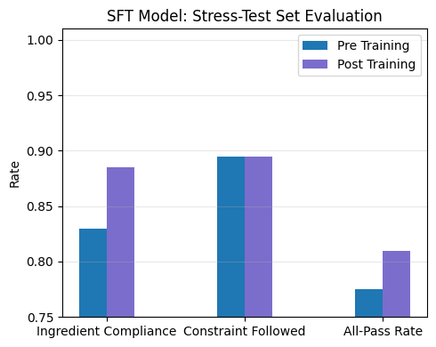
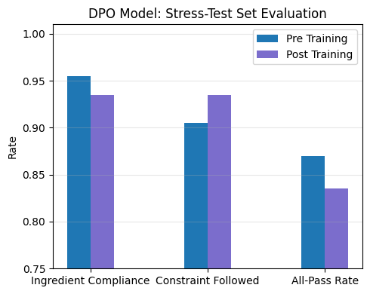
Impact of training data with harder constraints
Goal: Preference trained models should show better gain.

Slide 20
Key Takeaways
1
Strong base models can saturate simple constraint tasks
GPT-4.1-nano hits 98.25% all-pass with prompt engineering alone. SFT and DPO had almost no headroom to improve, masking the methods’ differences.
2
Harder data reveals a trade-off: DPO improves constraint reasoning, SFT improves surface compliance
DPO increases constraint-following but slightly lowers all-pass rate, showing better handling of complex requirements; SFT raises all-pass rate mainly via ingredient compliance, with no real gain in deeper constraint reasoning.
3
Future work — scale data, tune preferences, and move to online RL
SFT can benefit from more diverse and harder training data; DPO may improve with higher β to better enforce preferences; and a proper online RL / RFT setup can directly optimize for constraint-following.

Slide 21
Thanks a latte for your time !
Questions?

